Slide 1
Normal Conducting RF Cavity R&D for Muon Cooling
Derun Li
Center for Beam Physics
1st MAP Collaboration Meeting
February 28 – March 4, 2011
Thomas Jefferson National Accelerator Facility

Slide 2
Outline
Technical accomplishments
  Normal conducting RF cavities R&D and technology development of RF cavity for muon beams
    805 MHz and 201 MHz cavities
    Beryllium windows, etc.
  RF challenge: accelerating gradient degradation in magnetic field
  RF breakdown studies
    Box cavities and tests (Moretti)
    Surface treatment, ALD and HP cavities (ANL, FNAL and Muons Inc)
    Simulations (Z. Li)
  MAP Responsibilities in MICE (RF related)
    RF and Coupling Coil (RFCC) Module
      201-MHz RF cavities
      Coupling Coil Magnets
Outlook

Slide 3
Normal Conducting RF R&D
Muon bunching, phase rotation and cooling requires Normal Conducting RF (NCRF) that can operate at HIGH gradient within a magnetic field strength of up to approximately 6 Tesla
    ∼ 26 MV/m at 805 MHz
    ∼ 16 MV/m at 201 MHz
Design, engineering and construction of RF cavities
Testinf of RF cavities with and without Tesla-scale B field
RF breakdown studies, surface treatment, physics models and
simulations

Slide 4
What Have We Built So Far?
  Development of RF cavities with the conventional open beam irises terminated by beryllium windows
  Development of beryllium windows
    Thin and pre-curved beryllium windows for 805 and 201 MHz cavities
  Design, fabrication and tests of RF cavities at MuCool Test Area, Fermilab
    5-cell open iris cavity
    805 MHz pillbox cavity with re-mountable windows and RF buttons
    201 MHz cavity with thin and curved beryllium windows (baseline for MICE )
    Box cavities
    HP cavities
  RF testing of above cavities at MTA, Fermilab
    Lab-G superconducting magnet; awaiting for CC magnet for 201 MHz cavity

Slide 5
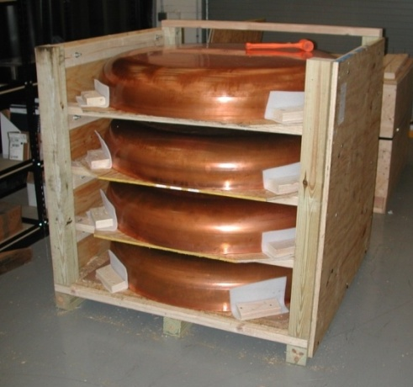
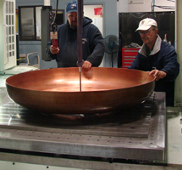
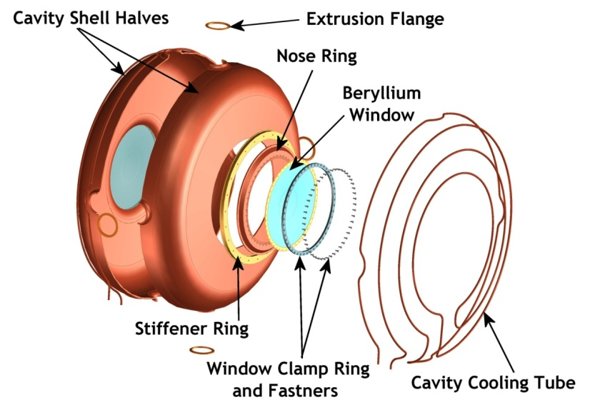
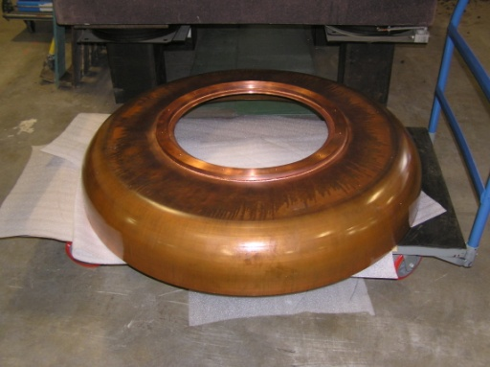
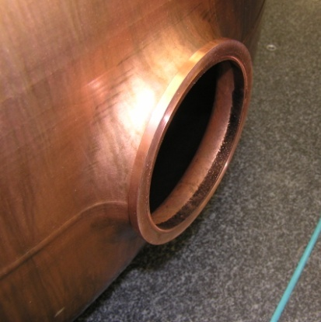
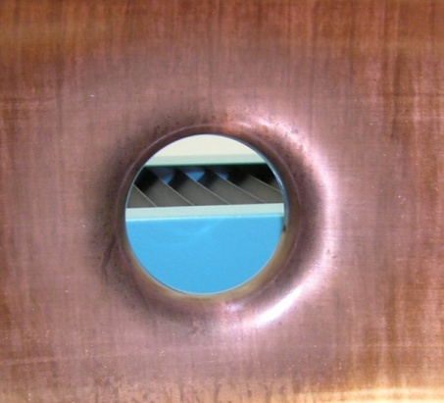
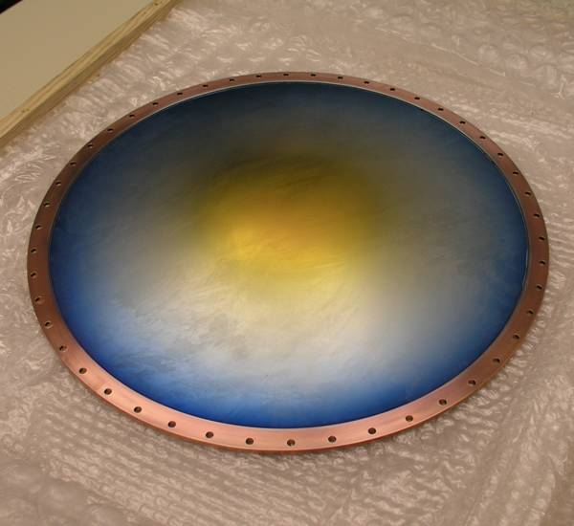
Development of 201 MHz Cavity Technology
Design, fabrication and test of 201 MHz cavity at MTA, Fermilab.
  Developed new fabrication techniques (with Jlab)

Slide 6
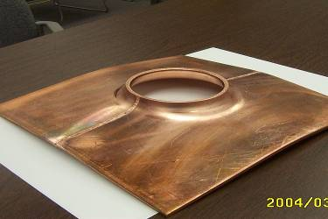
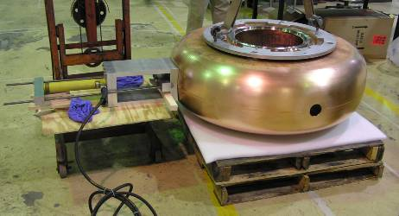
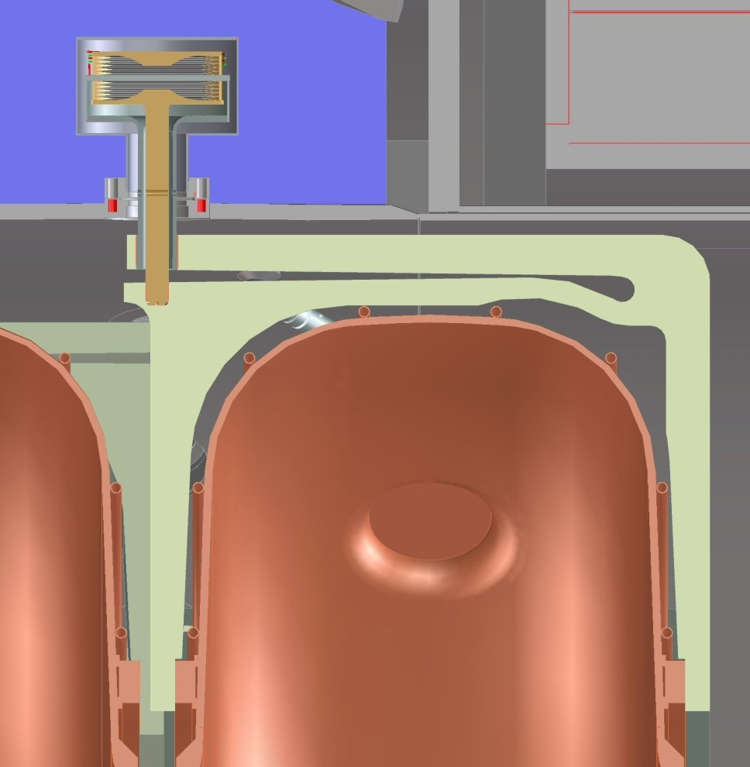
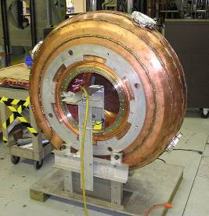
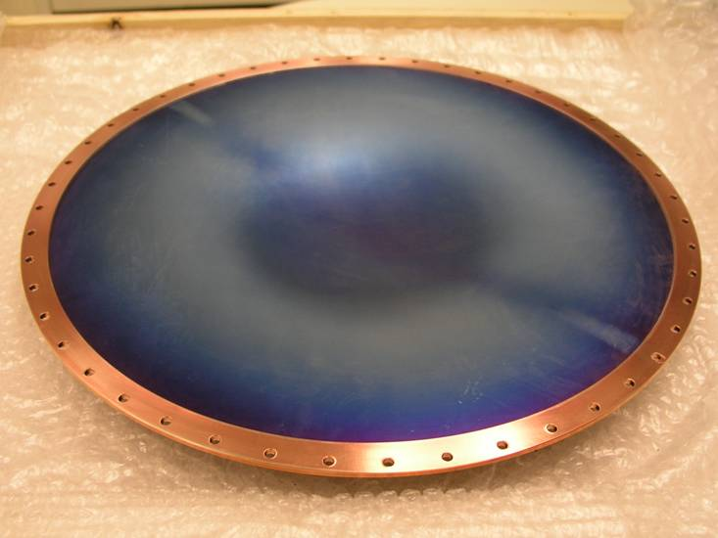
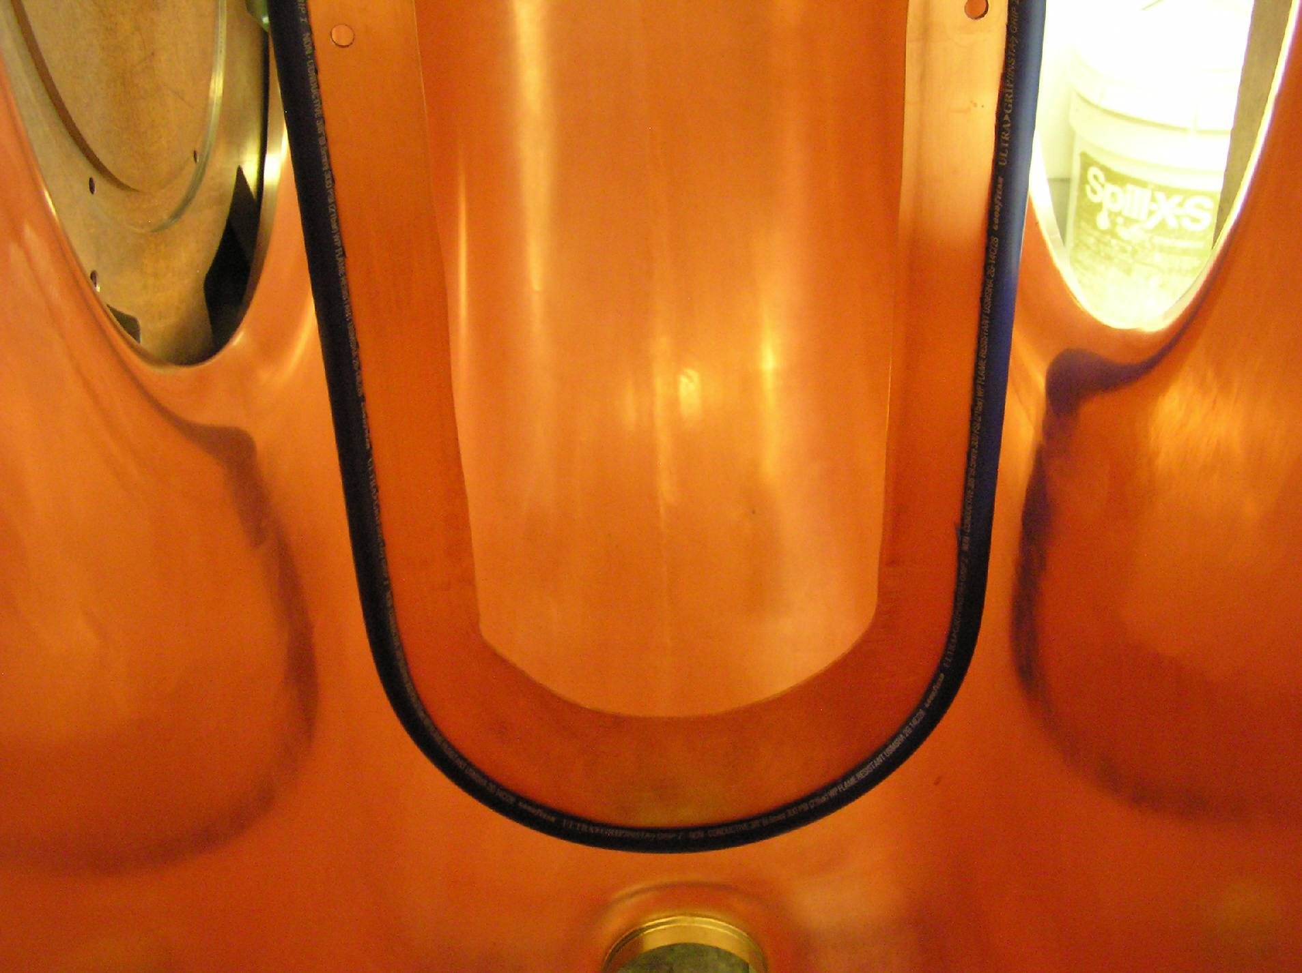
Development of Cavity Fabrication and Other Accessory Components (with JLab)
RF port extruding
Pre-curved thin Be windows
Tuner
42-cm
EP

Slide 7
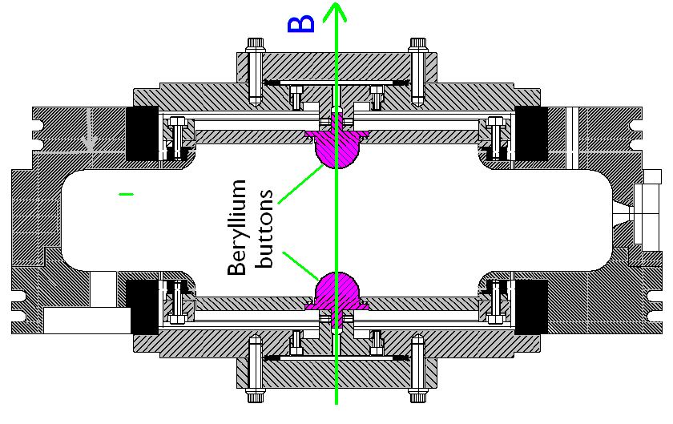
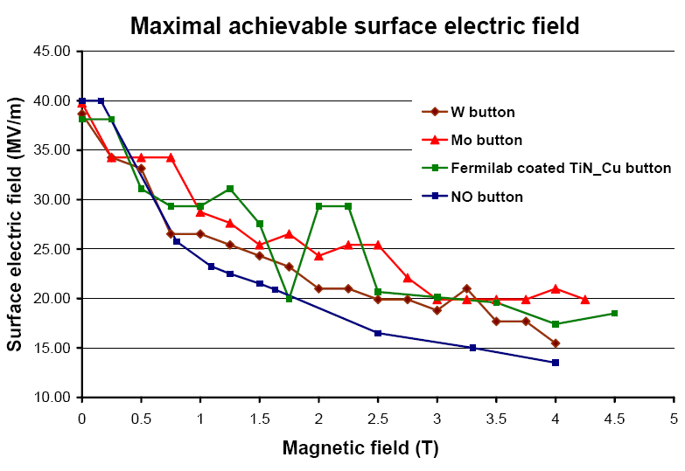
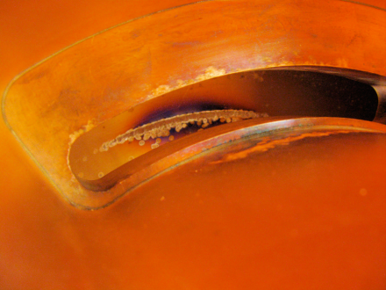
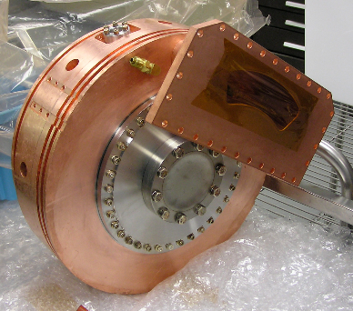
RF Challenge: Studies at 805 MHz
Experimental studies using LBNL pillbox cavity (with and without buttons) at 805 MHz: RF gradient degradation in B
Single button test results
Scatter in data may be due to surface damage on
the iris and the coupling slot

Slide 8
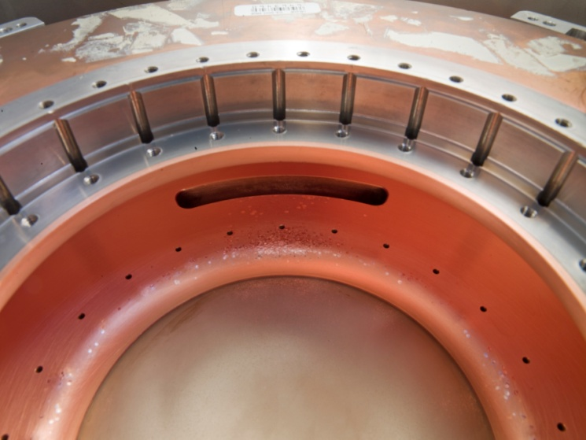
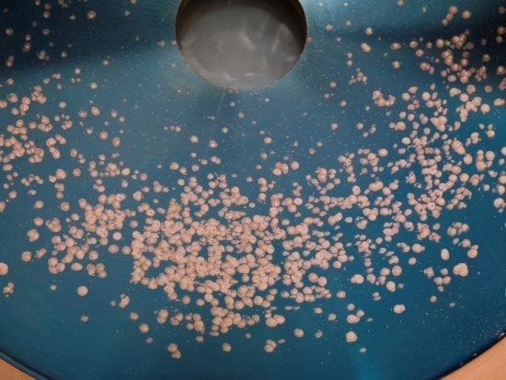
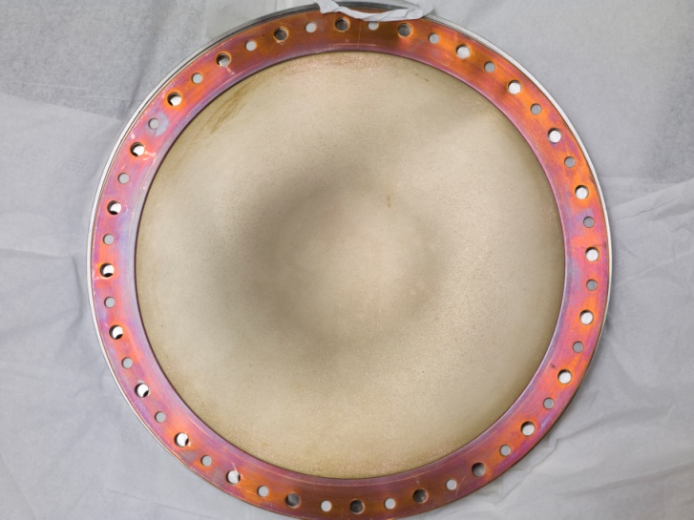
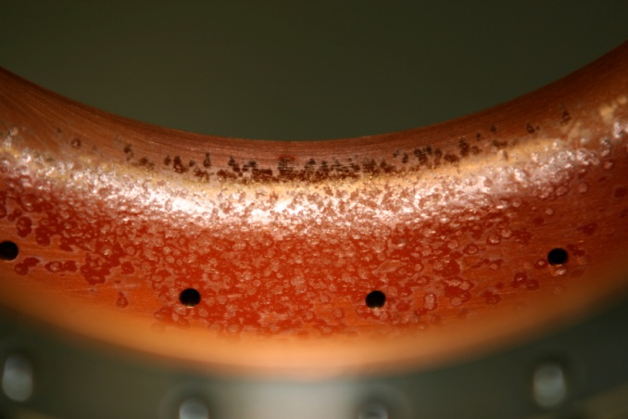
Surface Damage of 805 MHz Cavity
Significant damage observed
  Iris
  RF coupler
  Button holder
However
  No damage to Be window

Slide 9
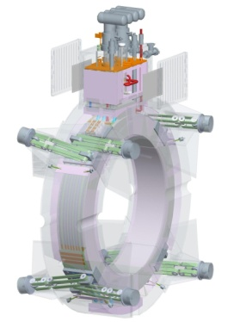
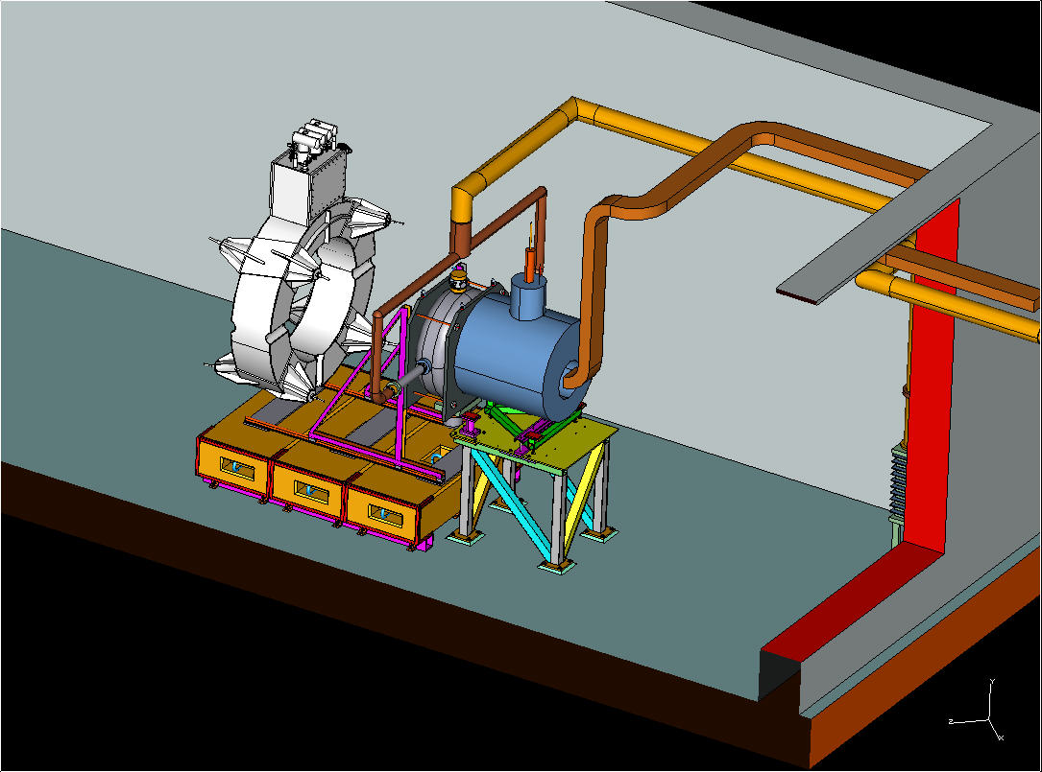
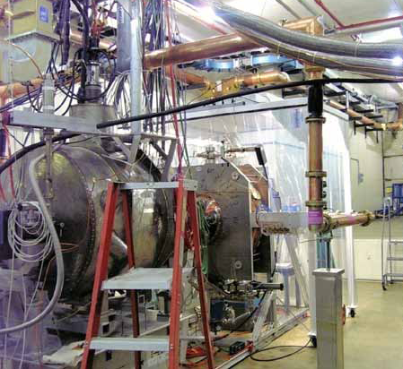
201 MHz Cavity Tests
Reached 19 MV/m w/o B, and 12 MV/m with stray field from Lab-G magnet
SC CC magnet
201-MHz Cavity
Lab G Magnet
MTA RF test stand

Slide 10
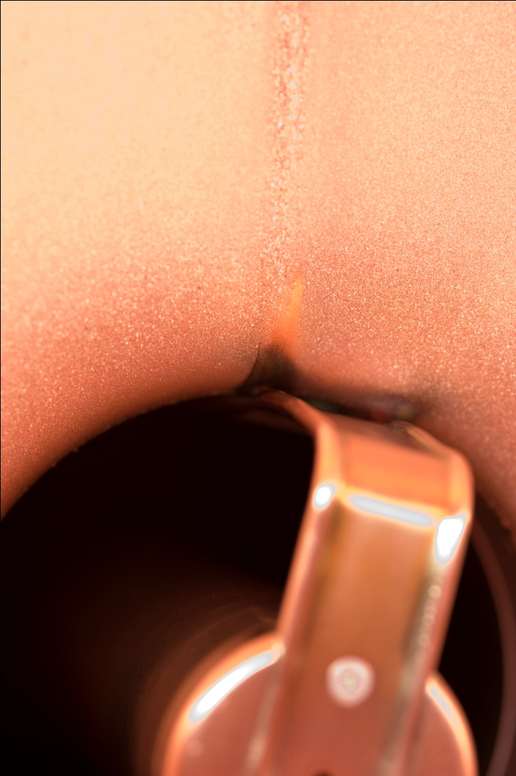
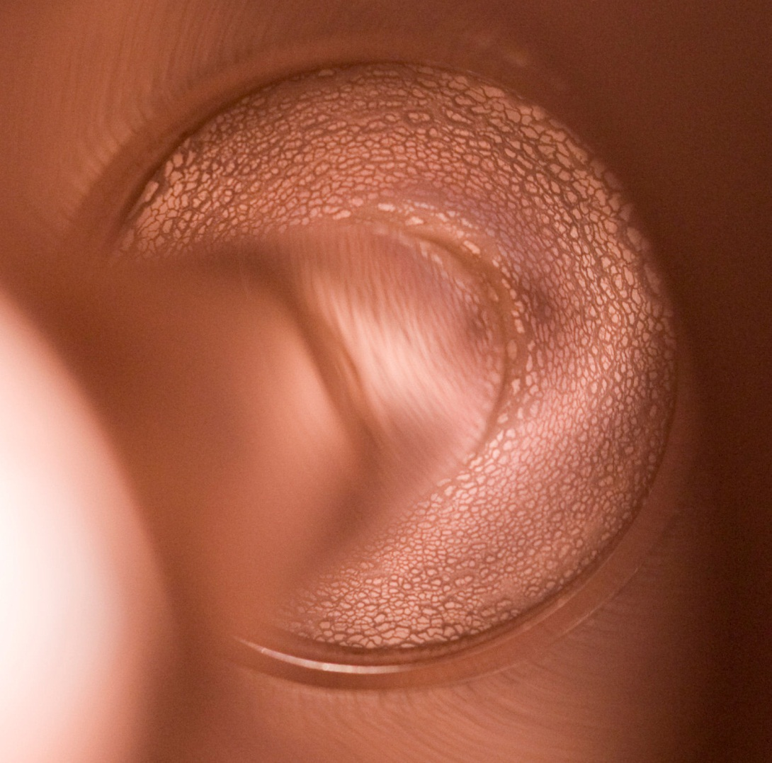
Damage of 201 MHz Cavity Coupler
Cu deposition on TiN coated
ceramic RF window
Arcing at loop
Surface analysis underway at ANL

Slide 11
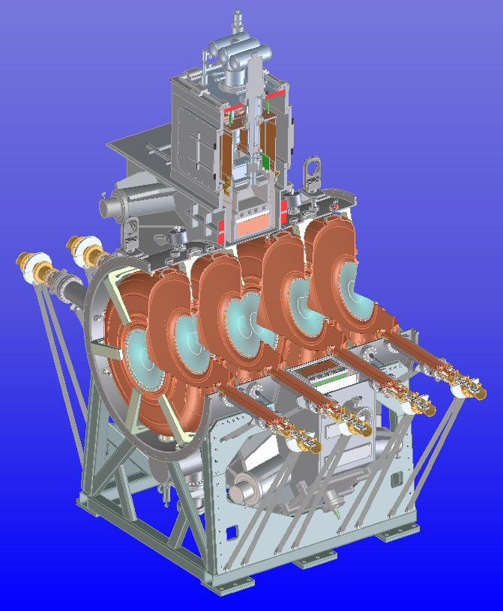

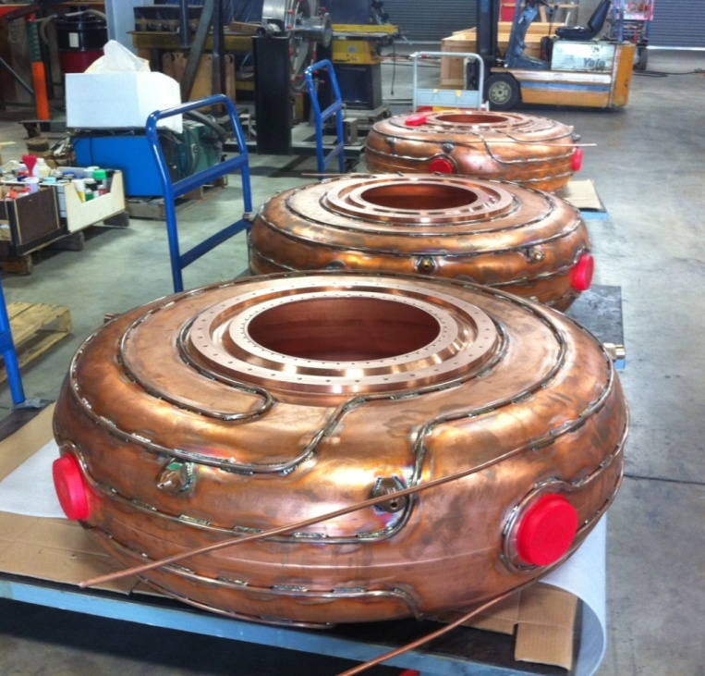
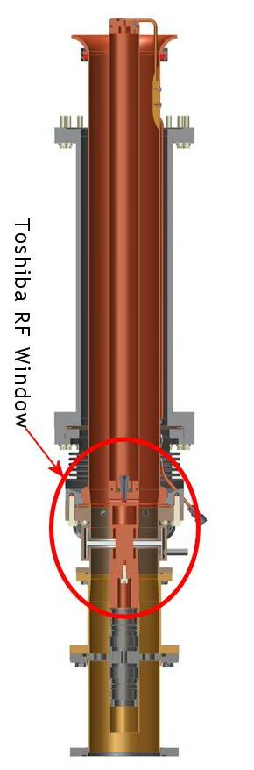
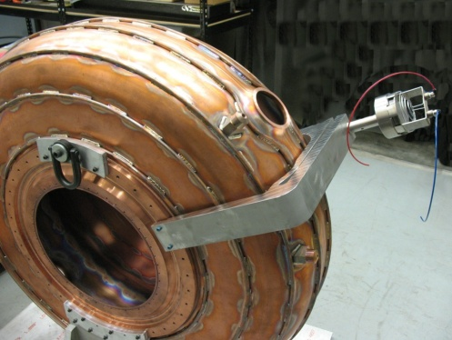
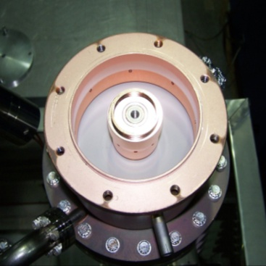
MICE RFCC Module: 201 MHz Cavity
Beryllium window
Sectional view
of RFCC module
Cavity fabrication
Coupler
tuner
RF window

Slide 12
Summary of MICE Cavity
  MICE RF cavities fabrication progressing well
Ten cavities with brazed water cooling pipes (two spares) complete in December 2010
  Five cavities measured
  Received nine beryllium windows, CMM scan to measure profiles
  Ten ceramic RF windows ordered (expect to arrive in March 2011)
  Tuner design complete, one tuner prototype tested offline
  Six prototype tuners in fabrication at University of Mississippi, and to be tested at LBNL this year
  Design of RF power (loop) coupler complete, ready for fabrication
  Design of cavity support and vacuum vessel complete
  Cavity post-processing (surface cleaning and preparation for EP) to start this year at LBNL

Slide 13
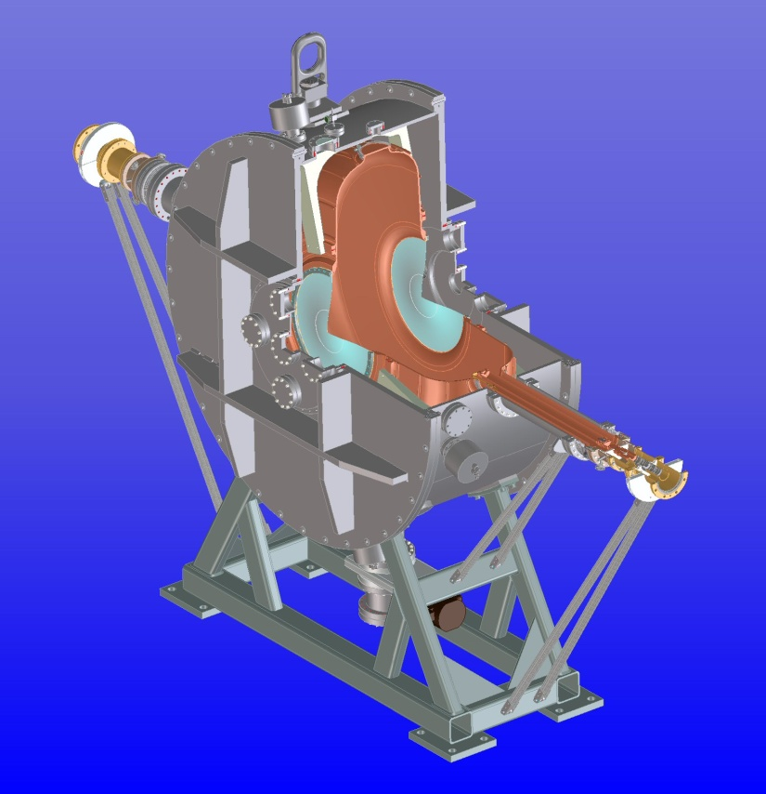
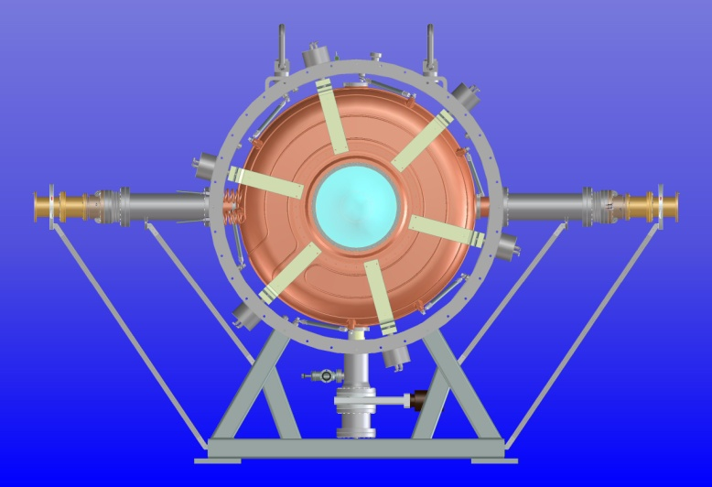
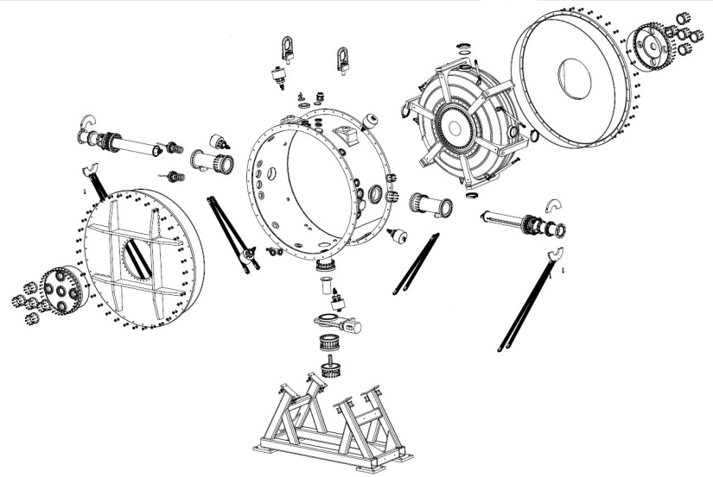
Single 201-MHz RF Cavity Vessel
Design is complete; Drawings are nearing completion
Kept the same dimensions and features of the RFCC (as much as possible)
One vessel designed to accommodate two types of MICE cavities (left and right)
The vessel and accessory components will soon be ready for fabrication

Slide 14
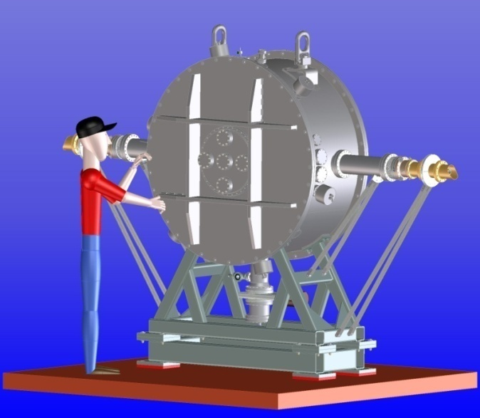
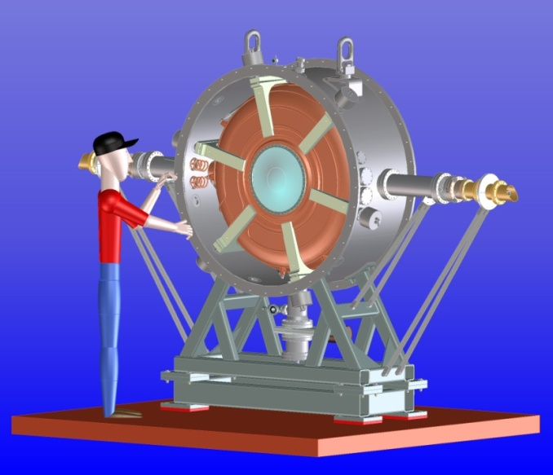
Advantages of Single Cavity Vessel
Prior to having MICE RFCC module, the single cavity vessel will allow us to:
Check engineering and mechanical design
Test of the RF tuning system with 6 tuners and actuators on a cavity and verify the frequency tuning range
Obtain hands-on experience on assembly and procedures
  Cavity installation
    Beryllium windows
    RF couplers and connections
    Water cooling pipe connections
    Vacuum port and connections
    Tuners and actuator circuit
  Aligning cavity with hexapod support struts
  Vacuum vessel support and handling
  Verify operation of the getter vacuum system
Future LN operation

Slide 15
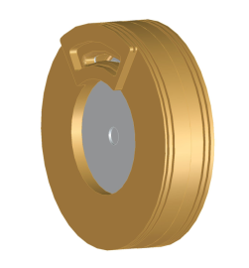
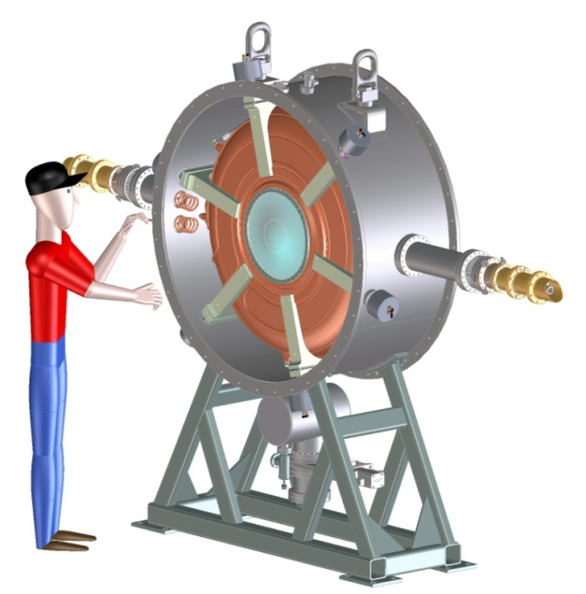
Outlook: RF for Muon Beams
NC RF R&D for muon cooling
  RF challenge: achievable RF gradient decreased by more than a factor of 2 at 4 T
  Understanding the RF breakdown in magnetic fields
    Physics model and simulations
    Experiments: RF button tests, HP &Beryllium-wall RF cavity (design and fabrication)
  MAP Responsibilities in MICE (RF related)
    Complete 201 MHz RF cavities
      Tuners: prototype, tests and fabrications
      Post-processing: Electro-polishing at LBNL
      Fabrication of RF power couplers
    CC magnets
      Final drawings of cryostat and cooling circuit
      Fabrication of the cryostat, cold mass welding and test
      Assembly of the CC magnets
    Assembly and integration of RFCC modules
  Single cavity vacuum vessel design and fabrication
805 MHz
Be-wall cavity
Single cavity vessel

Slide 16
Muon Cooling Cavity Simulation With Advanced Simulation Codes ACE3P
SLAC Parallel Finite Element EM Codes: ACE3P
  Simulation capabilities
Previous work on muon cavity simulations
  200 MHz cavity with and without external B field
  805 MHz magnetically insulated cavity
  805 MHz pillbox cavity with external B field

Slide 17
Accelerator Modeling with EM Code Suite ACE3P
Meshing - CUBIT for building CAD models and generating finite-element meshes http://cubit.sandia.gov
Modeling and Simulation – SLAC’s suite of conformal, higher-order, C++/MPI based parallel finite-element electromagnetic codes
https://slacportal.slac.stanford.edu/sites/ard_public/bpd/acd/Pages/Default.aspx
Postprocessing - ParaView to visualize unstructured meshes & particle/field data http://www.paraview.org/
ACE3P (Advanced Computational Electromagnetics 3P)
Frequency Domain: Omega3P – Eigensolver (damping)
S3P – S-Parameter
Time Domain: T3P – Wakefields and Transients
Particle Tracking: Track3P – Multipacting and Dark Current
EM Particle-in-cell: Pic3P – RF guns & klystrons
Multi-physics: TEM3P – EM, Thermal & Structural effects
Notes:
17

Slide 18
ACE3P Capabilities
Omega3P can be used to
optimize RF parameters
- determine HOM damping, trapped modes & their heating effects
- design dielectric & ferrite dampers, and others
S3P calculates the transmission (S parameters) in open structures
T3P uses a driving bunch to
- evaluate the broadband impedance, trapped modes and signal sensitivity
- compute the wakefields of short bunches with a moving window
- simulate the beam transit in large 3D complex structures
Track3P studies
  multipacting in cavities & couplers by identifying MP barriers & MP sites
  dark current in high gradient structures including transient effects
Pic3P calculates the beam emittance in RF gun designs
TEM3P computes integrated EM, thermal and structural effects for normal cavities & for SRF cavities with nonlinear temperature dependence

Slide 19
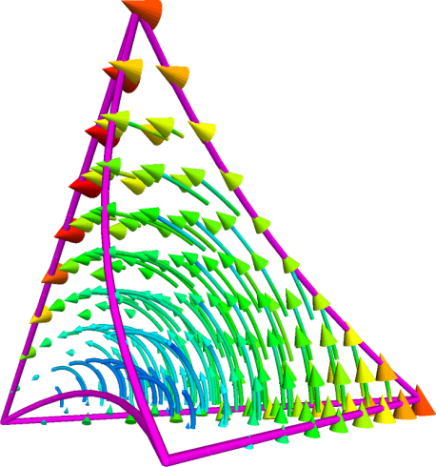
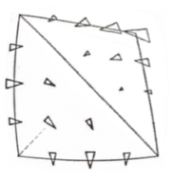
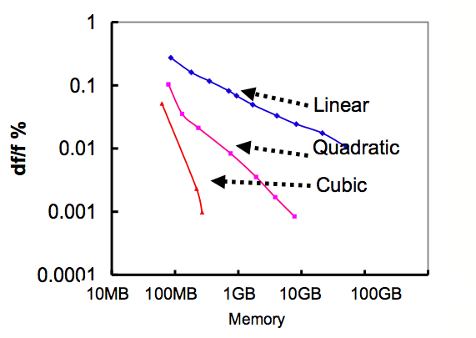
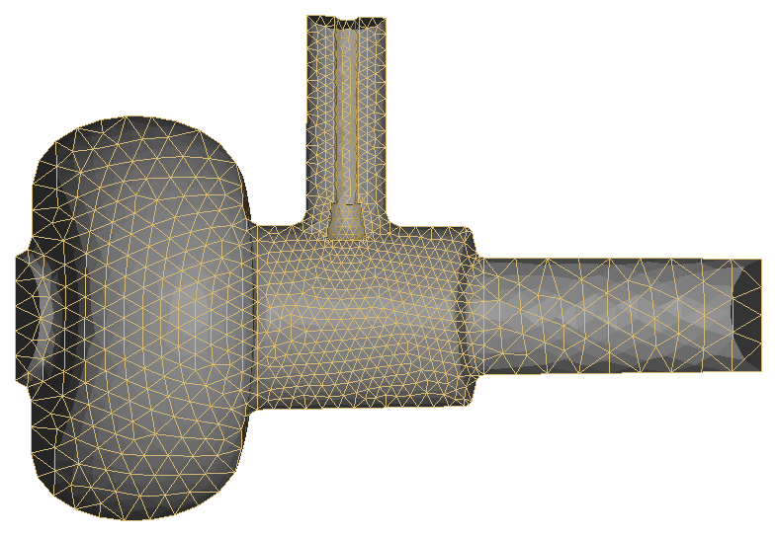
Parallel Higher-order Finite-Element Method
Strength of Approach – Accuracy and Scalability
Conformal (tetrahedral) mesh with quadratic surface
Higher-order elements (p = 1-6)
Parallel processing (memory & speedup)
N₂
dense
N₁
1.3
1.29975
67000 quad elements
(<1 min on 16 CPU,6 GB)
1.2995
F(GHz)
1.29925
1.299
End cell with input coupler only
1.29875
1.2985
0
100000
200000
300000
400000
500000
600000
700000
800000
mesh element
67k quad elements (<1 min on 16 CPU,6 GB) Error ~ 20 kHz (1.3 GHz)

Slide 20
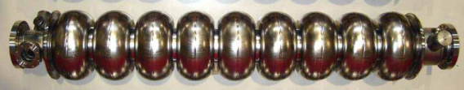
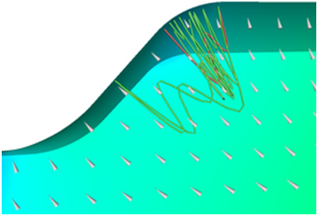

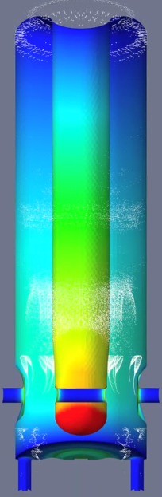
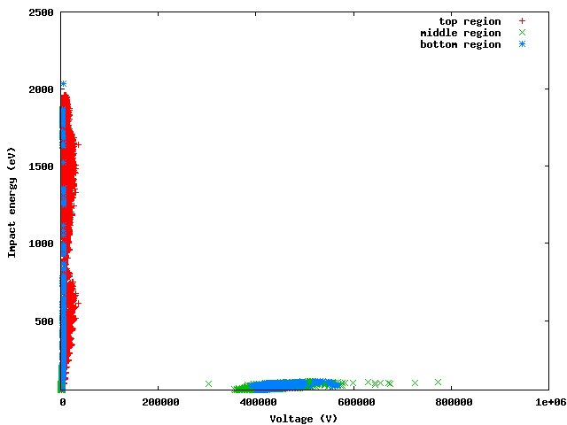
Track3P – Simulation vs measurement
ICHIRO #0 | Track3P MP simulation
X-ray Barriers (MV/m) | Gradient (MV/m) | Impact Energy (eV)
11-29.3 12-18 | 12 | 300-400 (6th order)
13, 14, 14-18, 13-27 | 14 | 200-500 (5th order)
(17, 18) | 17 | 300-500 (3rd order)
20.8 | 21.2 | 300-900 (3rd order)
28.7, 29.0, 29.3, 29.4 | 29.4 | 600-1000 (3rd order)
ICHIRO cavity
  Predicted MP barriers
FRIB QWR
  Experiment barriers agree with simulation results
Low voltage: impact energy fall in the region of SEY >1, hard barrier
Matched experiment at
1.2kV ~7.2kV
High voltage: impact energy too low, soft barrier
Peak SEY
Resonant particle distribution

Slide 21
Muon Cavity Simulation Using Track3P
200 MHz and 805 MHz muon cavity
Mutipacting (MP) and dark current (DC) simulations

Slide 22
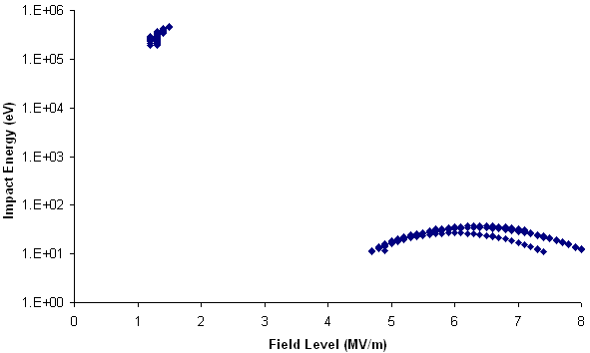
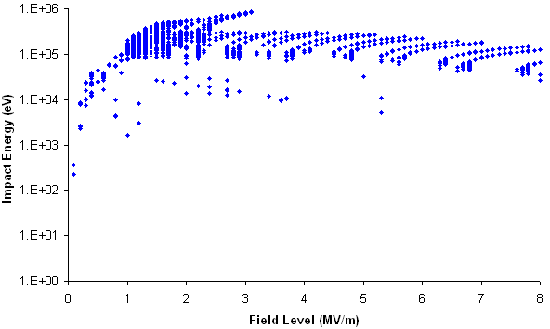
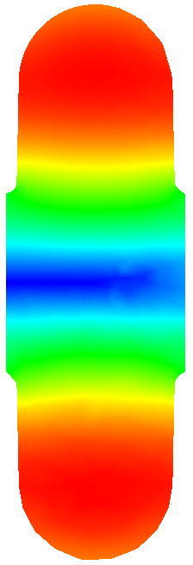
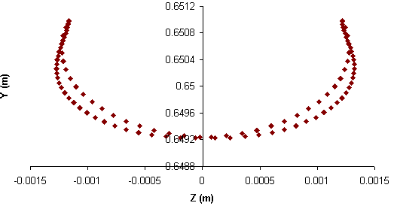
Impact energy of resonant particles vs. field level
200 MHz cavity MP and DC simulation
without external B field
with 2T external axial B field
High impact energy (heating?)
High energy dark current
SEY > 1 for copper
SEY > 1 for copper
Impact energy too low for MP
2 types of resonant trajectories:
Between 2 walls – particles with high impact energies and thus no MP
Around iris – MP activities observed below 1 MV/m
2T
Resonant trajectory
(D. Li cavity model)

Slide 23


200 MHz: With Transverse External B Field
Impact energy of resonant particles vs. field level
with 2T transverse B field
with 2T B field at 10 degree angle
SEY > 1 for copper
SEY > 1 for copper
2 types of resonant trajectories:
Between upper and lower irises
Between upper and lower cavity walls
Some MP activities above 6 MV/m
2 types of resonant trajectories:
One-point impacts at upper wall
Two-point impacts at beampipe
MP activities observed above 1.6 MV/m
2T
2T

Slide 24




805 MHz Magnetically Insulated Cavity
Track3P simulation with realistic external magnetic field map
Bob Palmer 500MHz cavity
Multipacting Region
None resonant particles

Slide 25




Pillbox Cavity MP with External Magnetic Field
Pillbox cavity w/o beam port
  Radius: 0.1425 m
  Height: 0.1 m
  Frequency: 805 MHz
  External Magnetic Field: 2T
  Scan: field level, and B to E angle (0=perpendicular)
E
B
Impact energy of resonant particles
External B 2T

Slide 26
Summary
Parallel FE-EM method demonstrates its strengths in high-fidelity, high-accuracy modeling for accelerator design, optimization and analysis.
ACE3P code suite has been benchmarked and used in a wide range of applications in Accelerator Science and Development.
Advanced capabilities in ACE3P’s modules have enabled challenging problems to be solved that benefit accelerators worldwide.
Computational science and high performance computing are essential to tackling real world problems through simulation.
The ACE3P User Community is formed to share this resource and experience and we welcome the opportunity to collaborate on projects of common interest.
User Code Workshops - CW09 in Sept. 2009
CW10 in Sept. 2010
CW11 planned fall 2011

